Slide 1
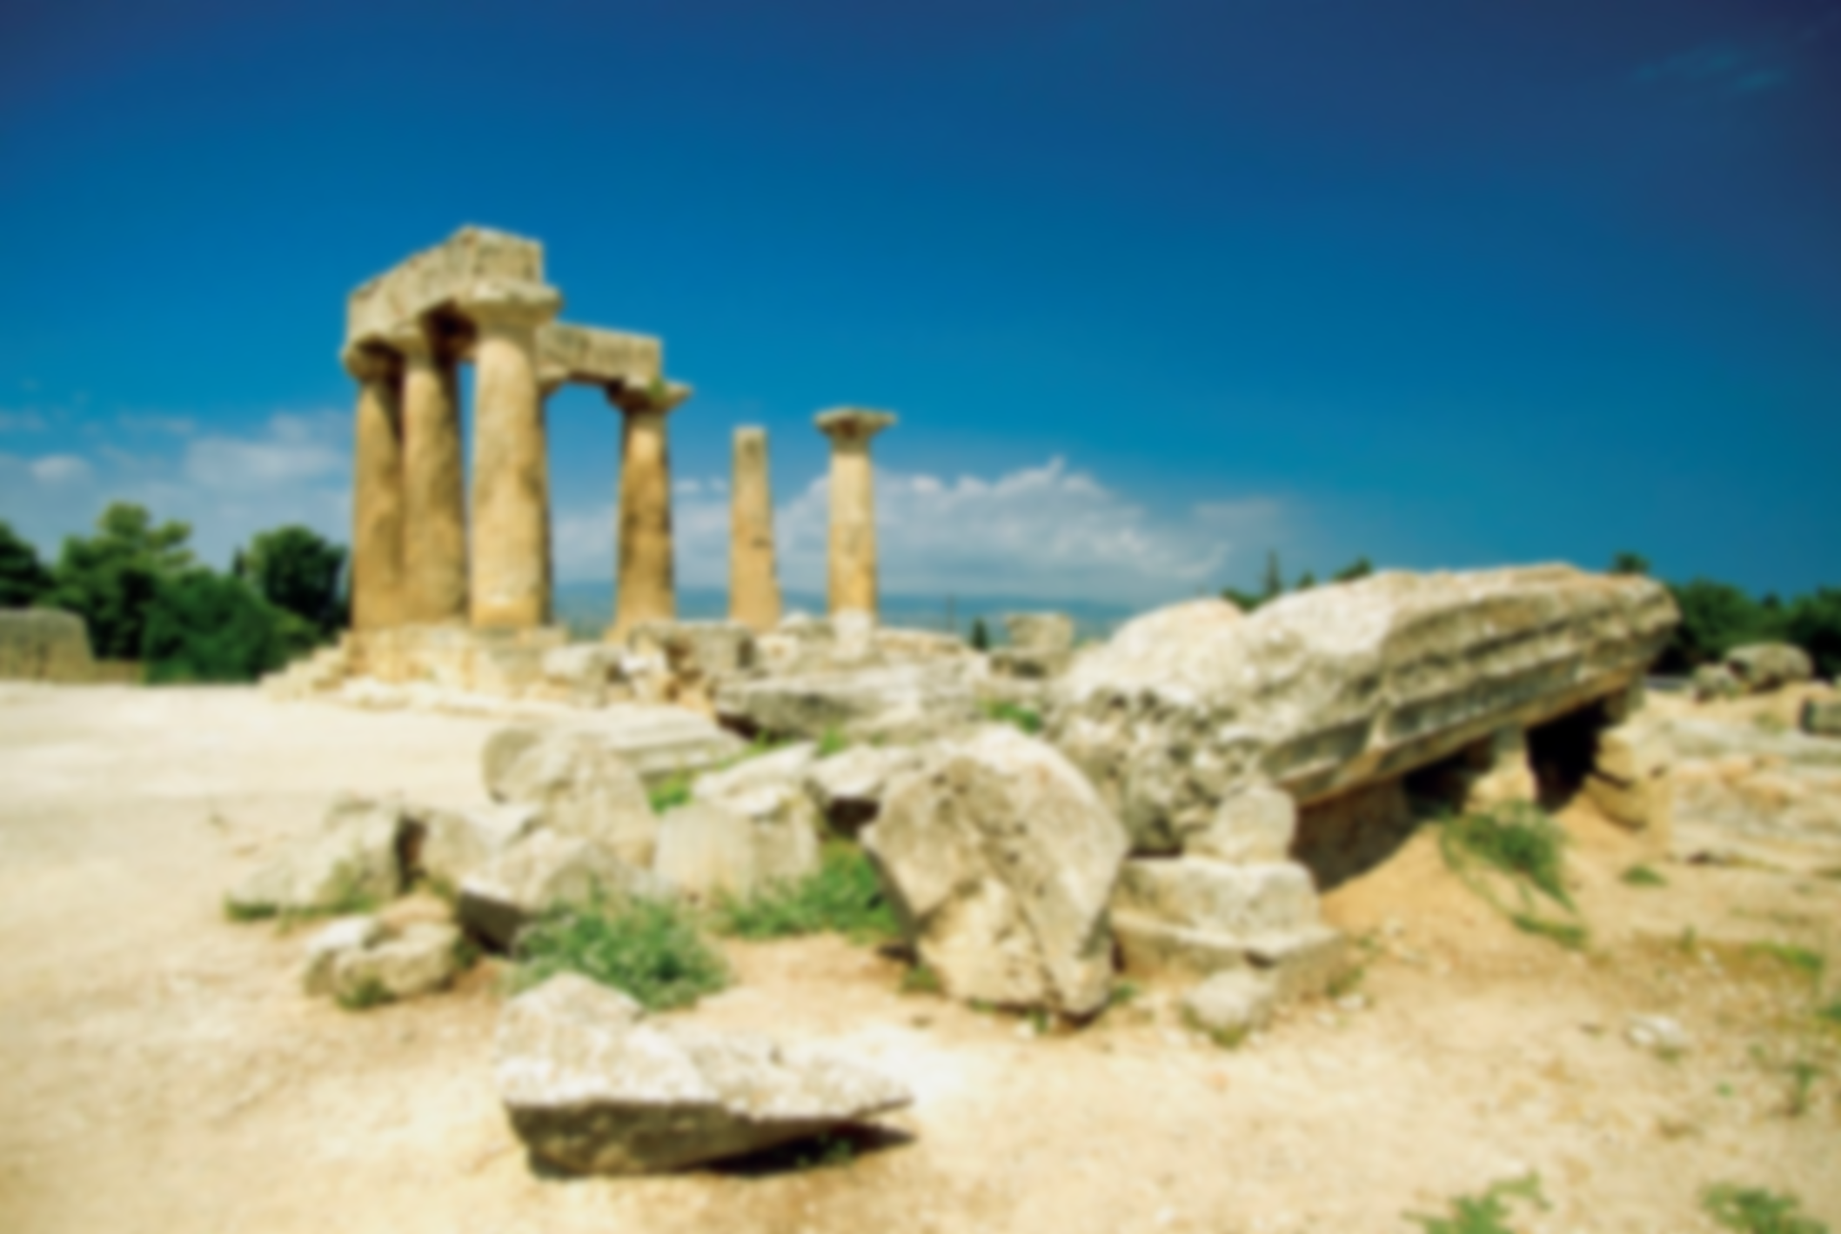
SINLAI 2 NA
1 KORINTE 1:1-9
THUPI
CHIBAI BUKNA
LEH
KIPAHTHU GENNA

Slide 2
SINLAI 2 NA
TANGVOM
1 KORINTHTE 1:8
Aman I Toupa Jesu Khrist Ni chiang a gensiatbei a na omna ding un, atawppha in ahon hihkip behlap ding hi.

Slide 3
SINLAI 2 NA
1
CHIBAI BUKNA (1:1-3)
A. LAIKHAKTUTE
Paul
Sostheni
B. LAIKHAK A OMTE HIHNA
Korinth Khua a Pathian Saptuamte:
Khrist Jesu a Sehtuam Siangthoute:
Misiangthou Hiding a Sapte:
Gamchih a Jesu Khrist Minlou tengteng amau leh eite

Slide 4
SINLAI 2 NA
1
CHIBAI BUKNA (1:1-3)
C. DEIHSAKNA THUPUAK
Pathian leh Toupa apan Hehpihna
Pathian leh Toupa apan Lemna

Slide 5
SINLAI 2 NA
2
KIPAHTHU GENNA (1: 4-9)
II. KIPAHTHU GENNA (1: 4-9)
Kipahna ziakte (1:4-7)
1. Khrist Jesu a Pathian hehpihna a muh ziak un (v4)
2. Bangkim ah hihhau a a-om ziak un (v5)
Thugen ah
Theihna ah
3. Khrist thu theihsak amau a hihkip ahihziak in (v6)
4. Khalam thilpiak ataksaplouh ziak un (v7)

Slide 6
SINLAI 2 NA
2
KIPAHTHU GENNA (1: 4-9)
B. MABAN LAMETNA (1:8-9)
1. Khrist Ni Chiang a Gensiatbei a Om ding (v8a)
2. Atawppha a Hihkip a Om ding (v8b)
3. Toupa Jesu Khrist toh Kithuahna ding (v9)

Slide 7
SINLAI 2 NA
SINDING
Pathian apan deihsakna leh hamphatna I tante thei gige ni.
Midang vualzawlna tante kipahpihtu hihsawm ni
Honsampa muanhuai lua ahihman in Amah ah I lametna nga ni

